Slide 1


Jenson USA SQL Project
DRIVEN INSIGHTS USING ADVANCE TECHNEQUES
PRESENTED BY
VARUN KUMAR
Notes:
AI-generated content may be incorrect. --- Welcome to the presentation focused on the Jenson USA SQL Project. We will explore the project's objectives, the significance of SQL in managing data, and how it aligns with Jenson USA's business needs.

Slide 2
Introduction to Jenson USA SQL Project
Data source : Jenson USA
Notes:
The Jenson USA SQL Project is designed to streamline data management and enhance decision-making processes. This section will provide an overview of the project's objectives and the role of SQL in achieving these goals.

Slide 3


Agenda for Jenson USA SQL Project
SQL queries designed to extract insights regarding
customer behavior
employee performance
inventory control
store operations
EMPLOYING
Notes:
This presentation will cover the key components of the Jenson USA SQL Project. We will start with an introduction outlining the goals of the project and its importance. Following that, we will explore the interactive image slide, discussing its purpose and user interaction instructions.

Slide 4
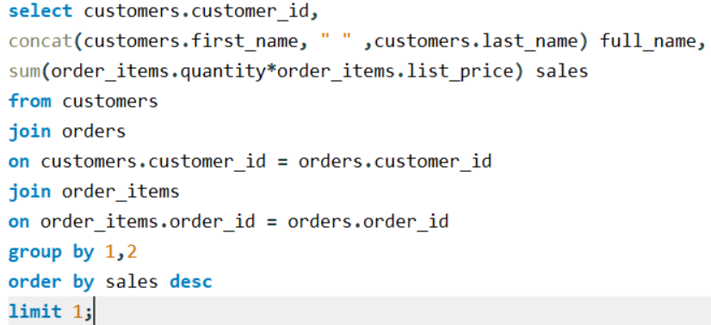

Find the customer who spent the most money on orders.
SQL Command :
Customer Behavior
Output
Notes:
The primary objective of the Jenson USA SQL Project is to develop a robust database system that supports efficient data retrieval and analysis. This project aims to improve operational efficiency and data-driven decision-making across the organization.

Slide 5
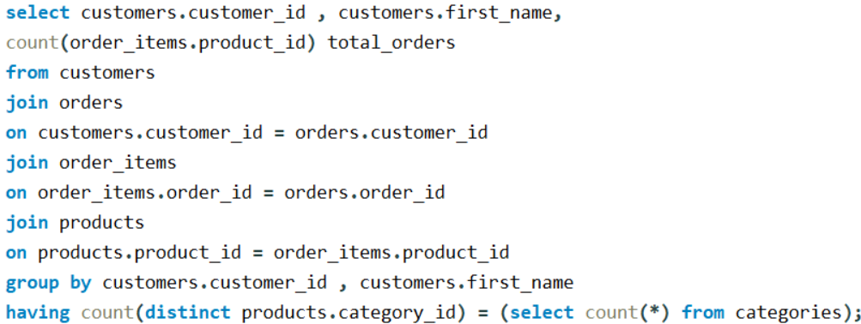

Customer Behavior
SQL Command :
Identify the customers who have ordered all types of products (i.e., from every category).
Output
Notes:
SQL, or Structured Query Language, is essential for managing and manipulating databases. It allows for efficient querying, data manipulation, and ensures data integrity, making it a fundamental tool in data management for businesses.

Slide 6
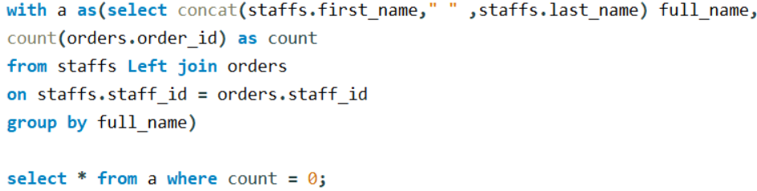
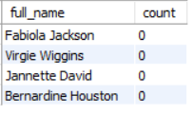
Staff Performance
SQL Command :
Find the names of staff members who have not made any sales.
Output
Notes:
Jenson USA operates in a competitive market, necessitating effective data management strategies. The project addresses their requirement for a dynamic database solution that caters to their diverse data needs, from inventory management to customer analytics.

Slide 7

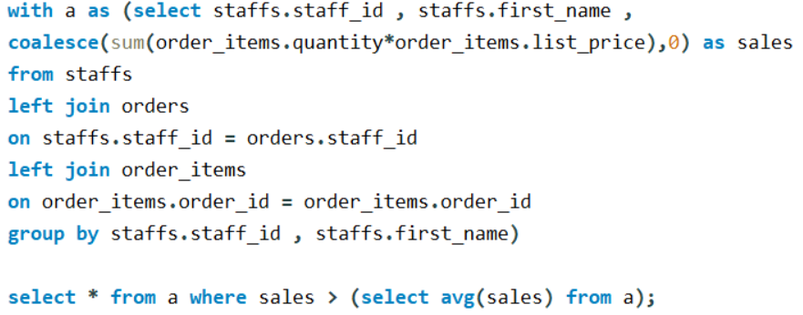

Staff Performance
SQL Command :
List the names of staff members who have made more sales than the average number of sales by all staff member.
Output
Notes:
The interactive image is intended to provide a visual representation of the database structure and relationships within the Jenson USA SQL Project. It enhances understanding and retention of complex data interactions.

Slide 8
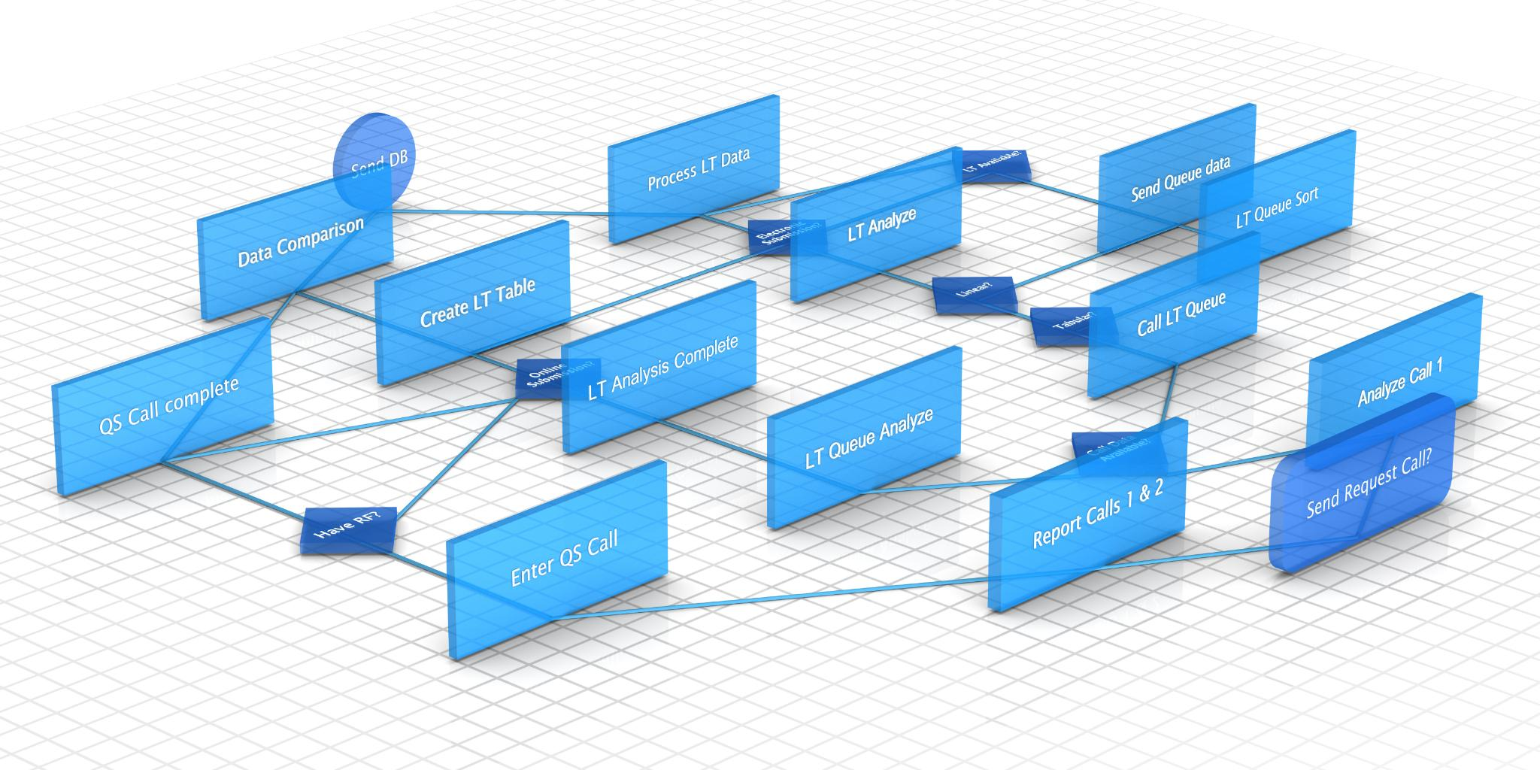
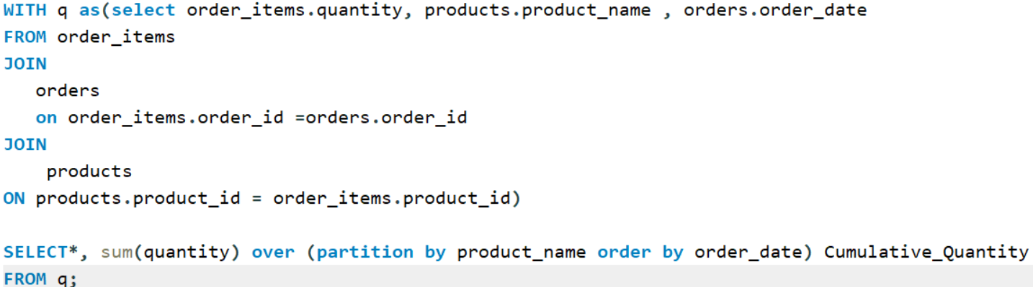
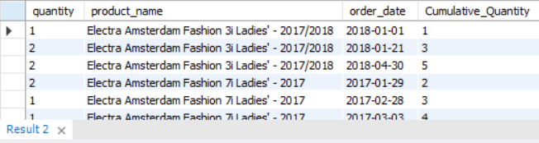
Inventory Management
SQL Command :
Output
Calculate the cumulative sum of quantities sold for each product over time.
Notes:
Key features of the interactive image include clickable elements that reveal additional information about database tables, relationships, and queries. This user-friendly approach allows for a deeper understanding of the system architecture.

Slide 9
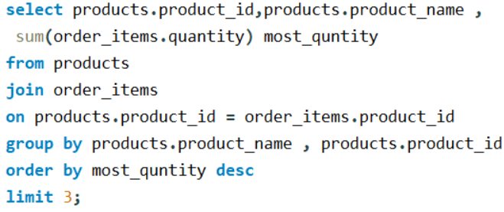

Inventory Management
SQL Command :
Output
Find the top 3 most sold products in terms of quantity.
Notes:
To interact with the image, users can click on various elements to explore different areas of the database. Hovering over specific features will display tooltips with further explanations, guiding users through the interactive experience.

Slide 10
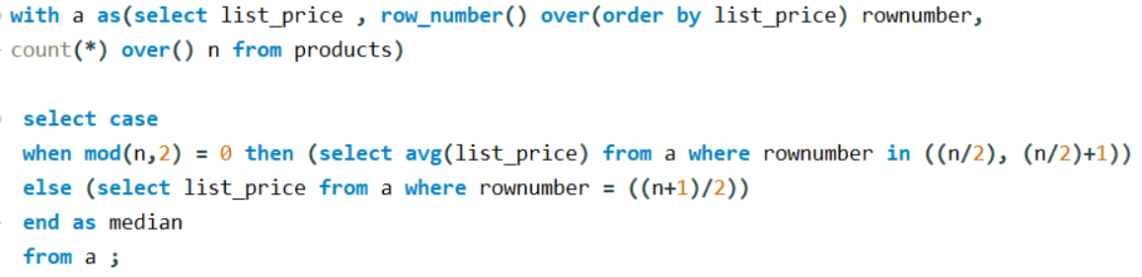

Inventory Management
SQL Command :
Find the median value of the price list.
Output
Notes:
To interact with the image, users can click on various elements to explore different areas of the database. Hovering over specific features will display tooltips with further explanations, guiding users through the interactive experience.

Slide 11
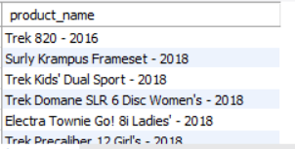
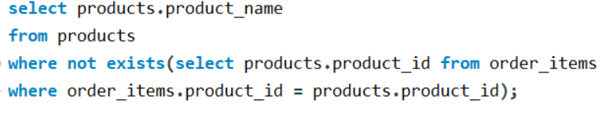
Inventory Management
Output
SQL Command :
List all products that have never been ordered (use EXISTS).

Slide 12
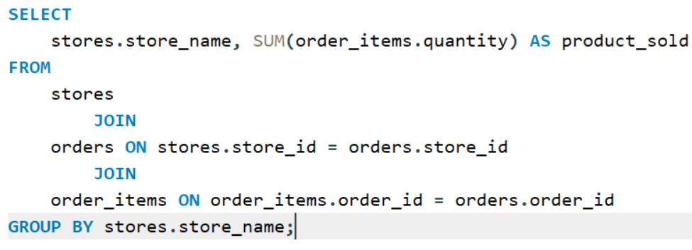
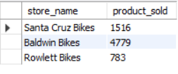
Store Operations
SQL Command :
Find the total number of products sold by each store along with the store .
Output

Slide 13
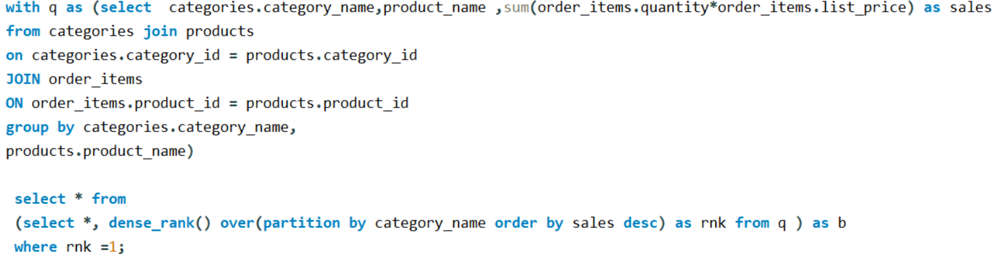
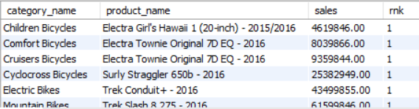
Store Operations
SQL Command :
Output
Find the product with the highest total sales (quantity * price) for each category.

Slide 14
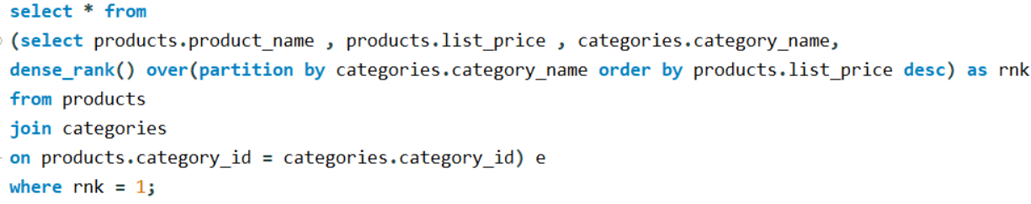
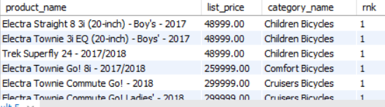
Store Operations
SQL Command :
Output
Find the highest-priced product for each category name.

Slide 15
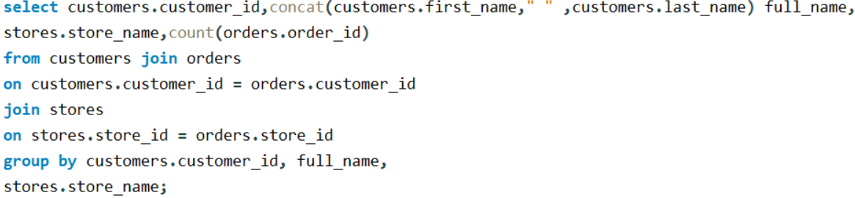
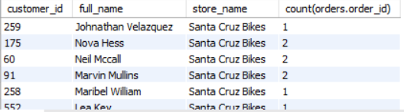
Store Operations
SQL Command :
Find the total number of orders placed by each customer per store.
Output

Slide 16

"Turning data into actionable insights".
The Originator
VARUN KUMAR
"Empowering decisions, one data-driven insight at a time."
Find this useful ? Don’t Forget To Like And Share This Post.

